Slide 1
Learning ASP.NET Core Web API

Slide 2
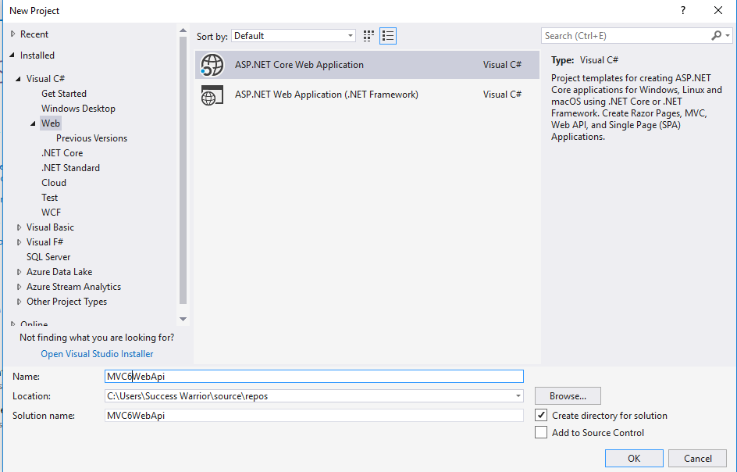

Slide 3
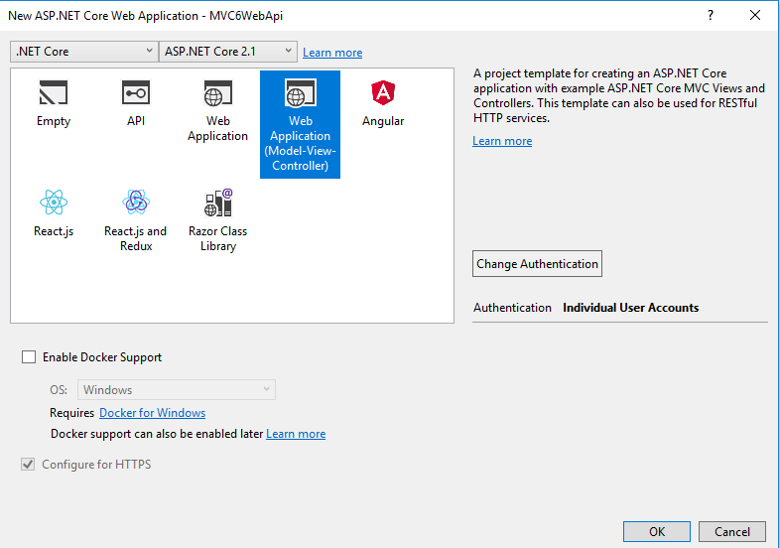

Slide 4
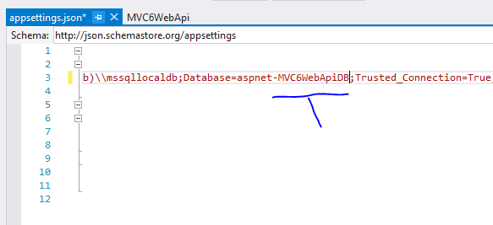

Slide 5
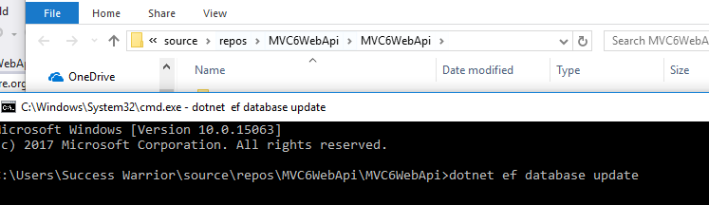

Slide 6
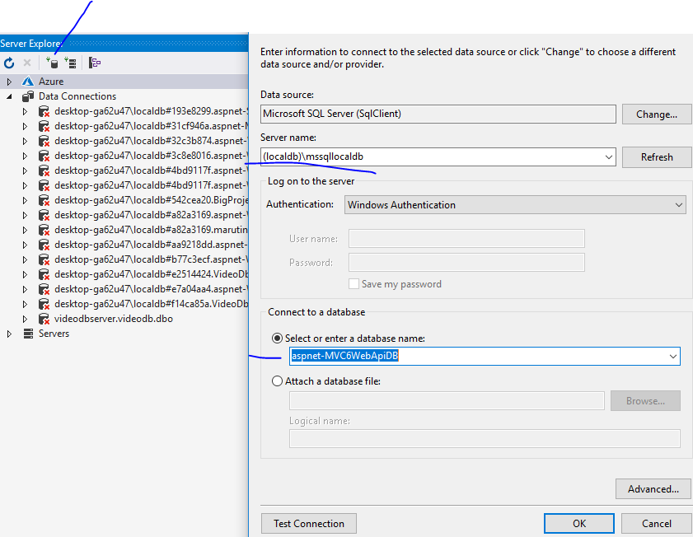

Slide 7
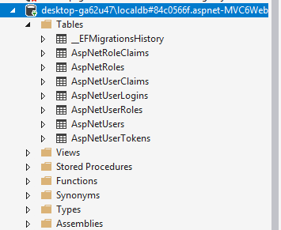

Slide 8
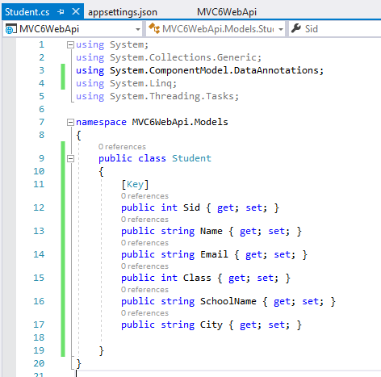

Slide 9
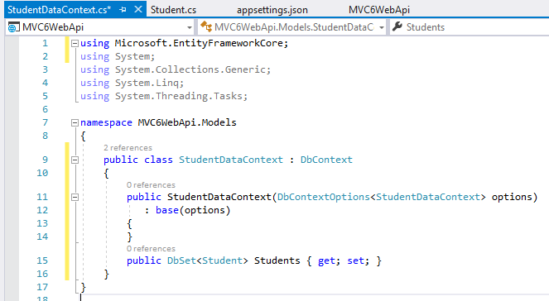

Slide 10
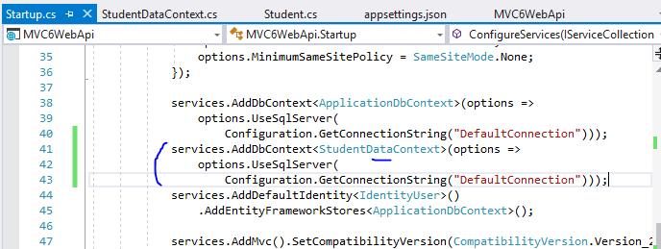

Slide 11
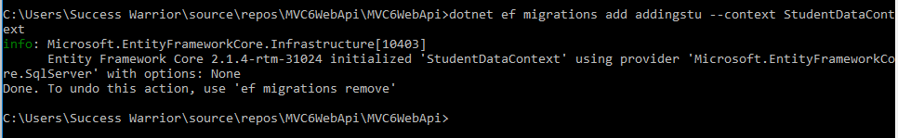
dotnet ef migrations add addingstu - -context StudentDataContext

Slide 12
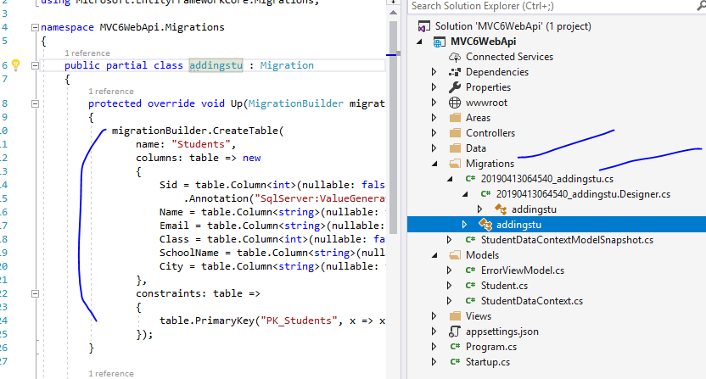

Slide 13
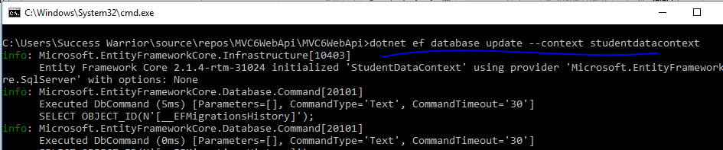
dotnet ef databse update - -context StudentDataContext

Slide 14
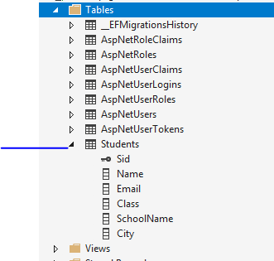

Slide 15
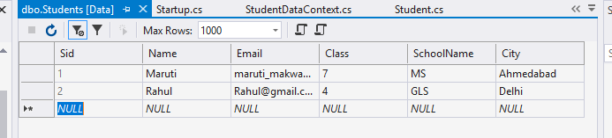

Slide 16
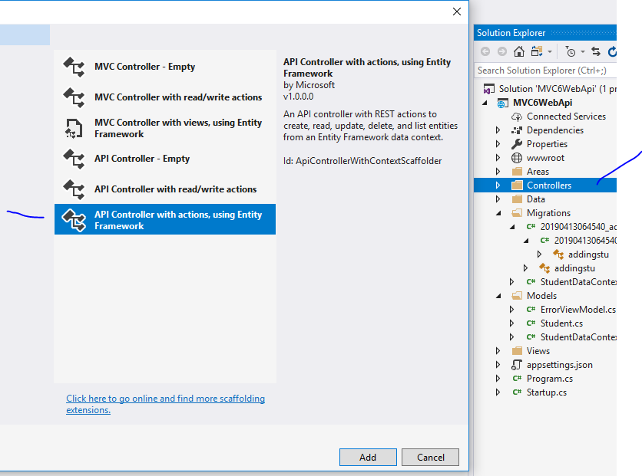

Slide 17
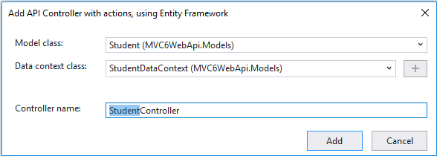

Slide 18
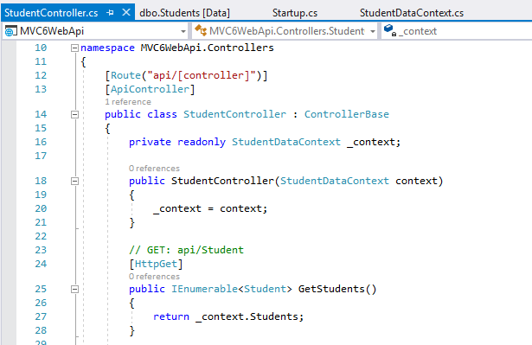

Slide 19
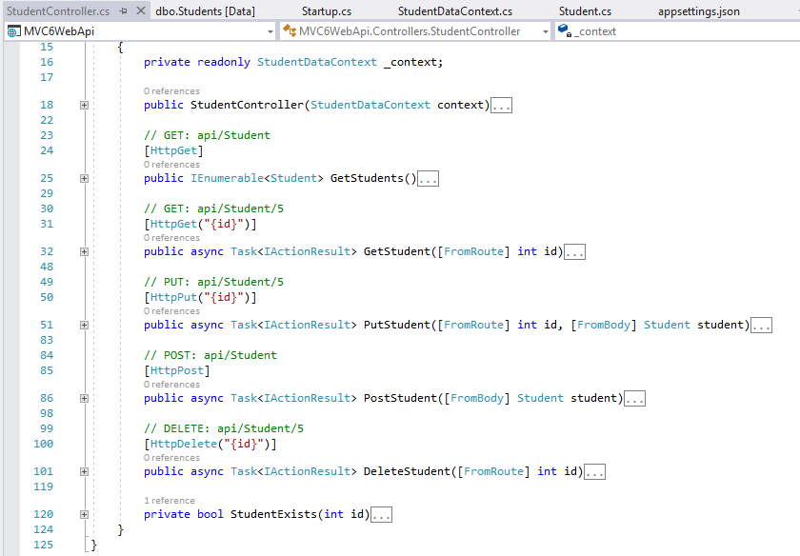

Slide 20
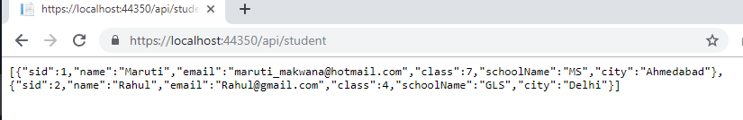
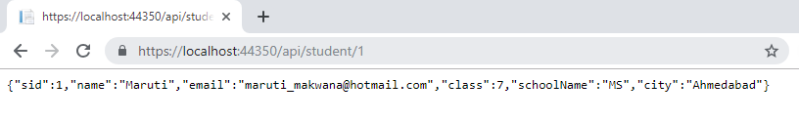

Slide 21
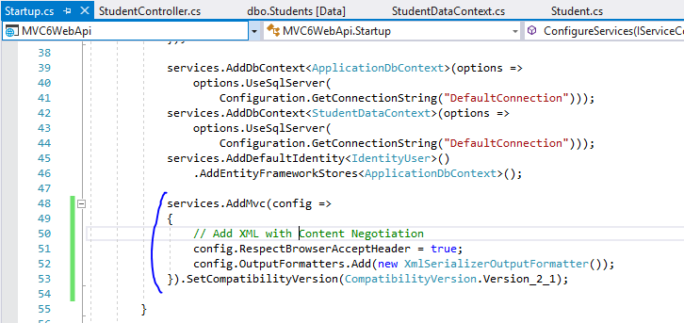

Slide 22
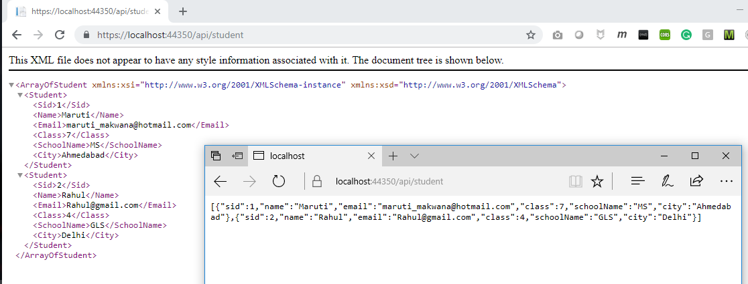

Slide 23
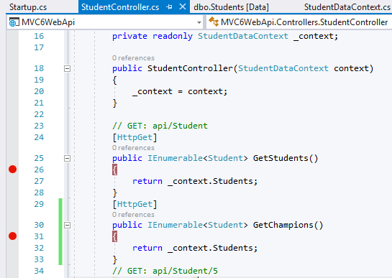

Slide 24
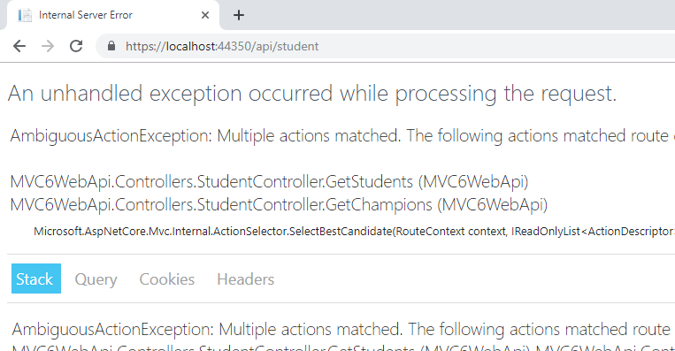

Slide 25
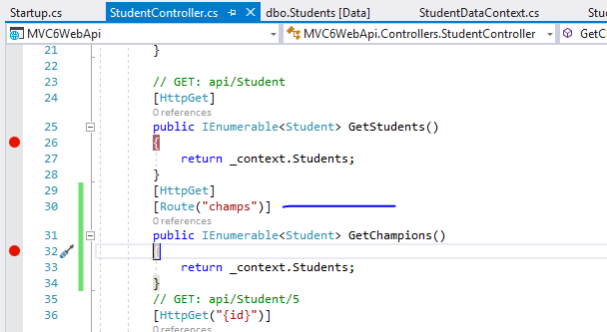

Slide 26
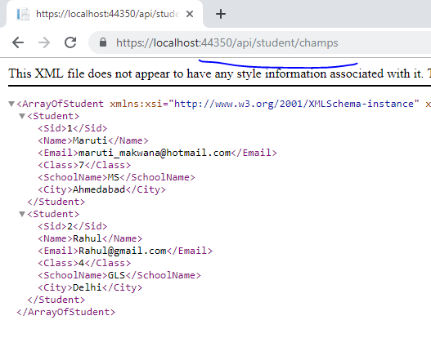

Slide 27
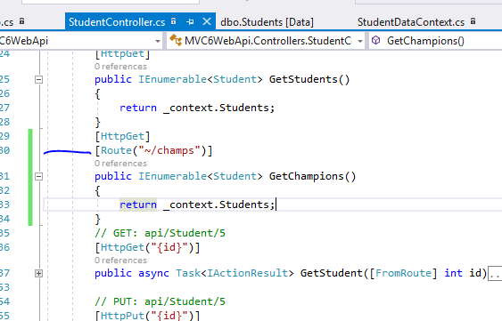

Slide 28
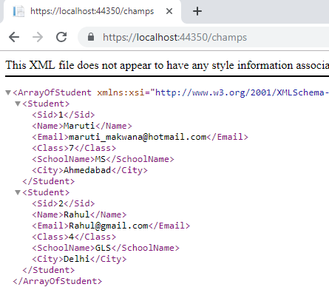

Slide 29
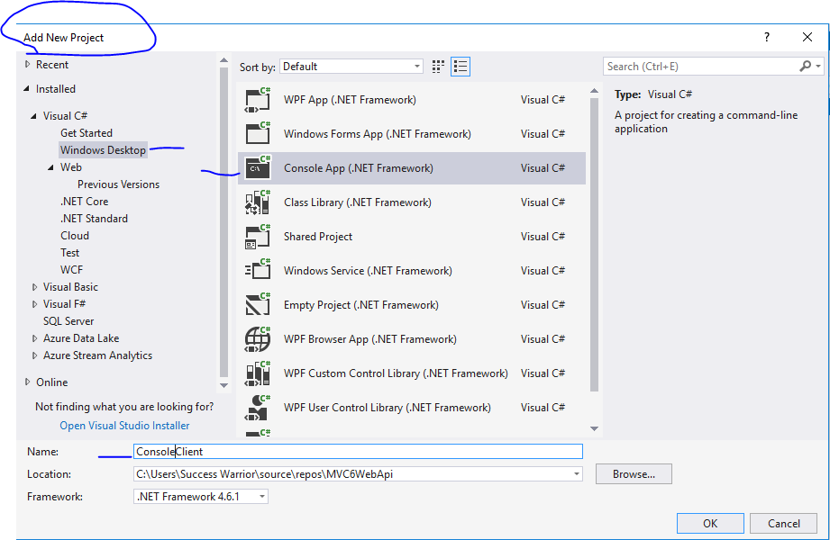
Inside Same solution

Slide 30
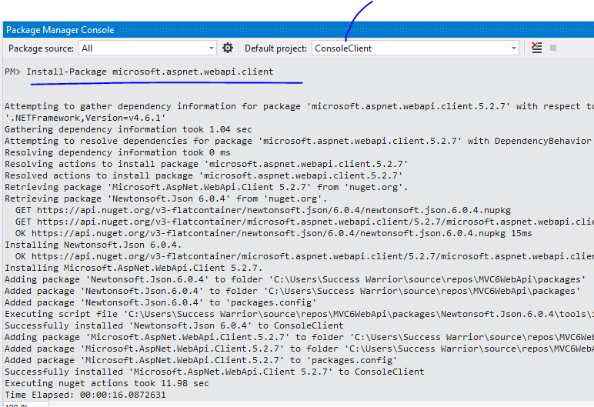

Slide 31
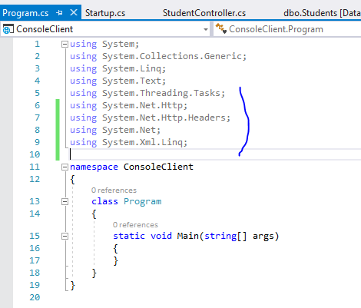

Slide 32
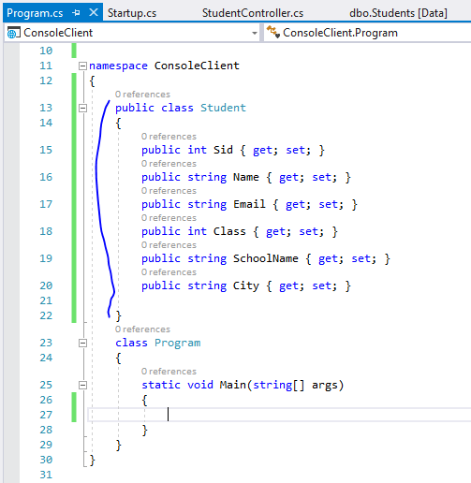

Slide 33
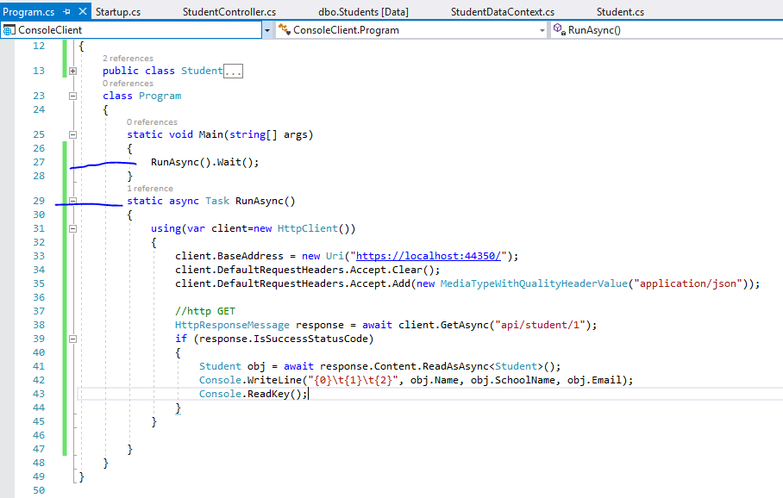

Slide 34
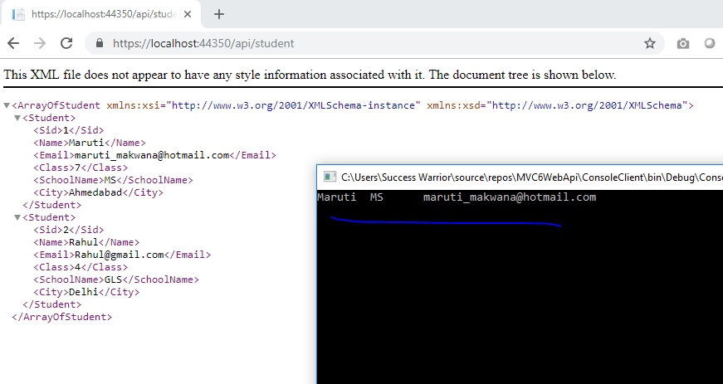

Slide 35
Now I want to consume this in angular
Application in JSON format only
ANGULAR 6 Onwards

Slide 36
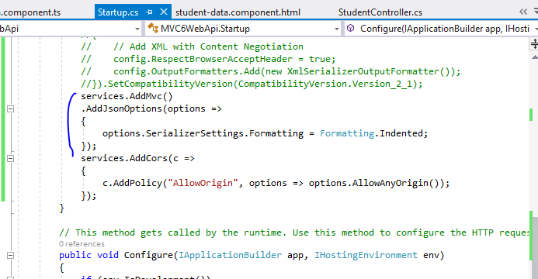

Slide 37
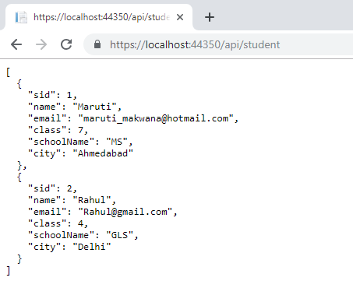
Much clean
Json data
With caml case

Slide 38
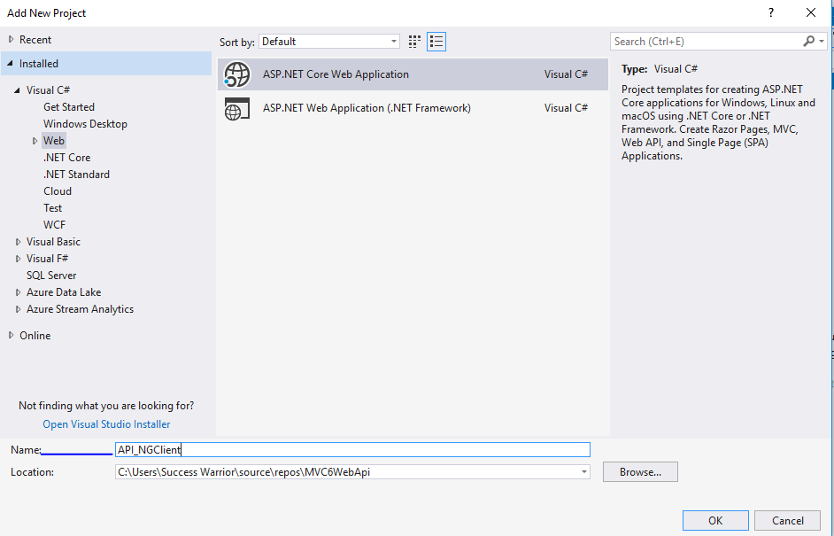

Slide 39
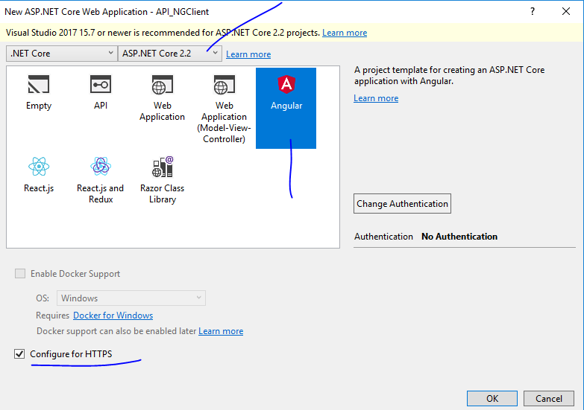

Slide 40
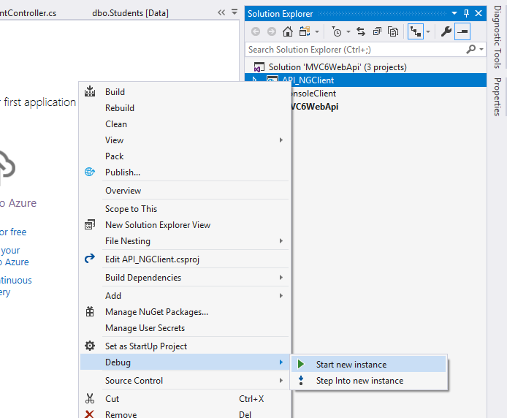

Slide 41
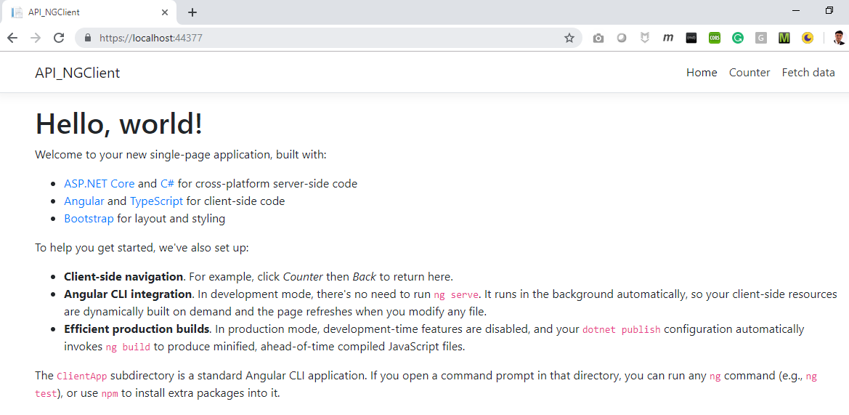

Slide 42
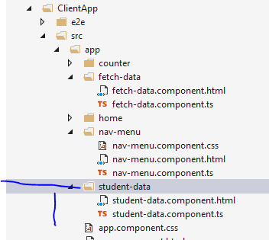

Slide 43
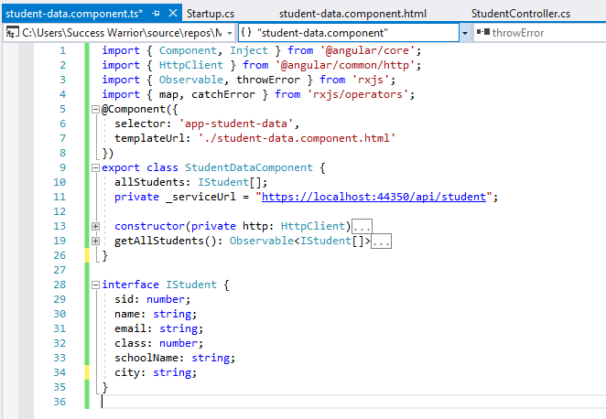

Slide 44
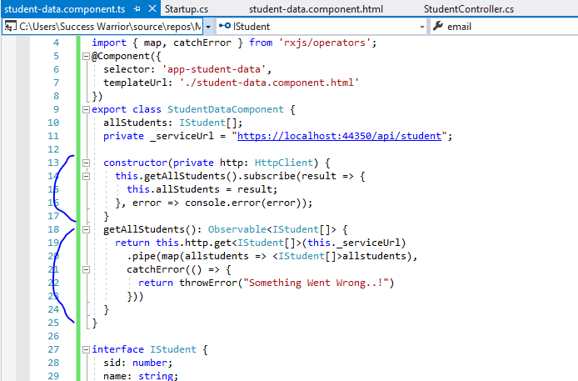

Slide 45
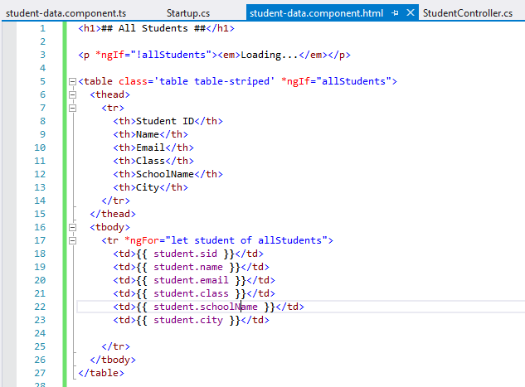

Slide 46
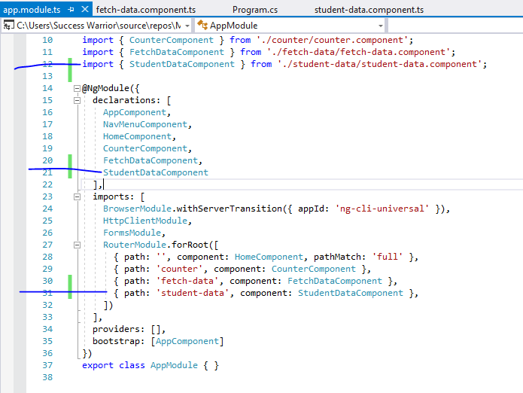

Slide 47
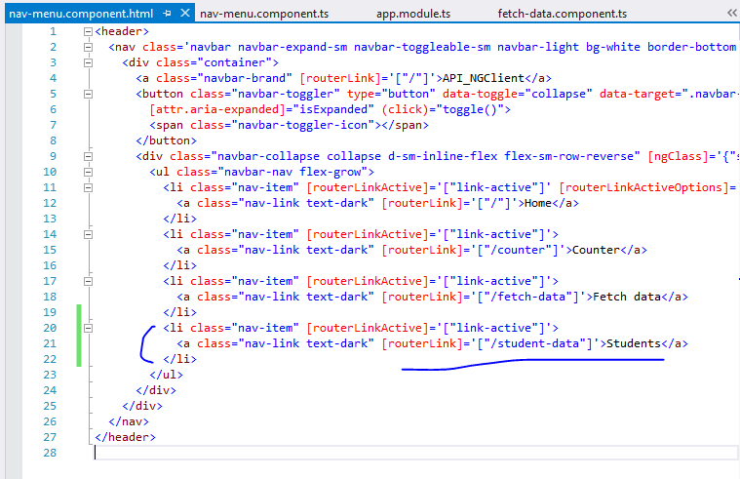

Slide 48
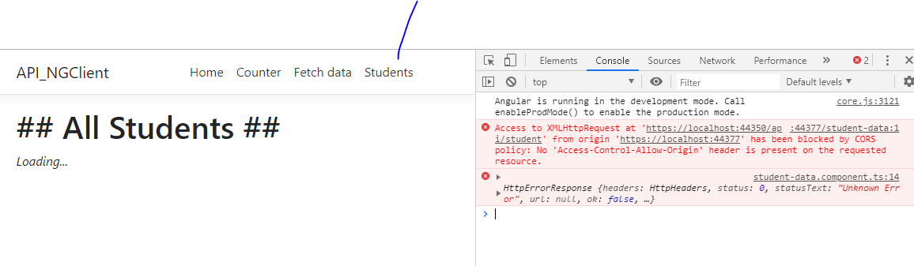
We need to enable CORS

Slide 49
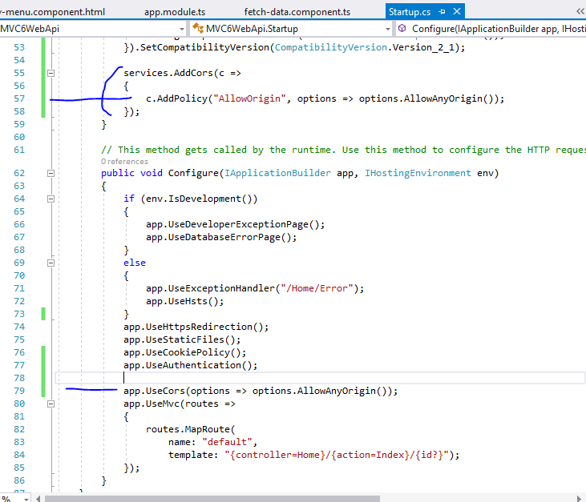
Add this code
In webapi
project

Slide 50
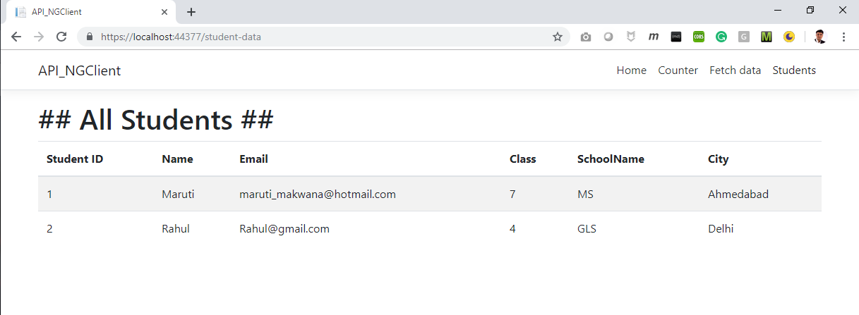

Slide 51
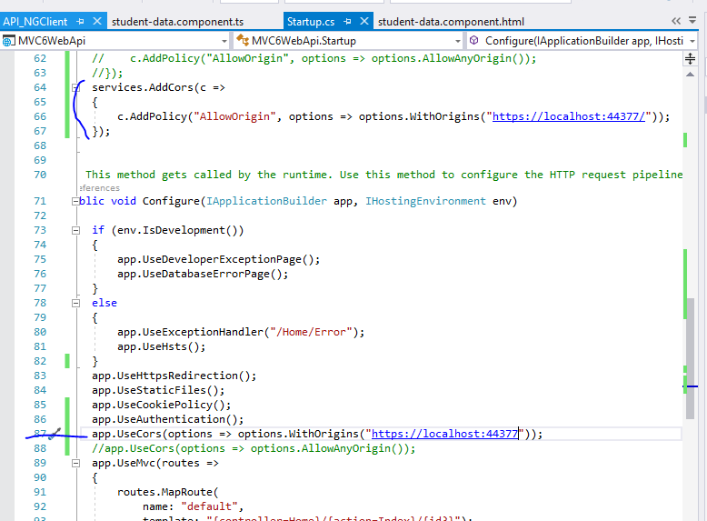

Slide 52


Slide 53

Still working

Slide 54
Now I want to create a StudentRepository called
StudentService which will be connecting
my controller With Model through DI

Slide 55


Slide 56


Slide 57



Slide 58


Slide 59


Slide 60


Slide 61



Slide 62
Now Let’s Try X-unit testing in this application

Slide 63


Slide 64


Slide 65


Slide 66


Slide 67
When writing unit tests it is usually the practice to follow the AAA principle (Arrange, Act and Assert):
Arrange – this is where you would typically prepare everything for the test, in other words, prepare the scene for testing (creating the objects and setting them up as necessary)
Act – this is where the method we are testing is executed
Assert – this is the final part of the test where we compare what we expect to happen with the actual result of the test method execution

Slide 68


Slide 69


Slide 70


Slide 71
Run both Tests

Slide 72


Slide 73


Slide 74


Slide 75


Slide 76


Slide 77


Slide 78


Slide 79


Slide 80


Slide 81


Slide 82


Slide 83


Slide 84


Slide 85


Slide 86


Slide 87


Slide 88


Slide 89


Slide 90


Slide 91

Checking
Only 2 records

Slide 92


